Slide 1


INTENSIVE TECHNICAL KNOWLEDGE FOR INTERNATIONAL MANAGEMENT STUDENTS
SUMMER School 2026
20TH OF JULY – 7th OF AUGUST 2026
AT THE FACULTY OF MANAGEMENT AND TECHNOLOGY
UNIVERSITY OF APPLIED SCIENCES, ESSLINGEN, GERMANY

Slide 2
SUMMER SCHOOL
INTENSIVE TECHNICAL KNOWLEDGE FOR INTERNATIONAL MANAGEMENT STUDENTS
Three courses:
Fundamentals of Material Science and their application in industry with a focus on steel on Vehicle Engineering
Manufacturing Technology and its application in Vehicle and Mechanical Engineering
Fundamentals of Statics and Strength Theory and their application in Vehicle and Mechanical Engineering
All courses are at Bachelor’s level, full-time and worth 6 ECTS

Slide 3
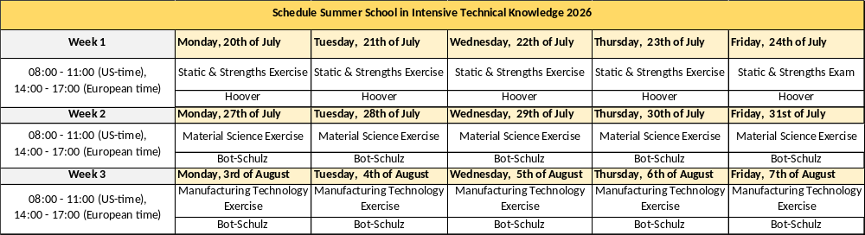
TIMETABLE
THEORETICAL LESSONS WILL BE AVAILABLE THROUGH VIDEO DOWNLOADS. THE VIDEOS WILL BE PROVIDED ONLINE 2 WEEKS BEFORE THE SEMINAR STARTS
VIDEOS HAVE TO BE WATCHED BEFORE AN EXERCISE.

Slide 4
COURSE DESCRIPTION
MATERIAL SCIENCE
LEARNING TARGETS:
Understand the structure of atoms and how the major crystal structures are built.
Introduction to important materials and their construction, properties, meaning and applicability with a focus on ferrous metals.
Understand the relationship between internal structure and their effect on functional properties of materials.
Learn to assess opportunities to further process materials.
Understand the possibilities and limitations of different material groups.

Slide 5
COURSE DESCRIPTION
MANUFACTURING TECHNOLOGY
LEARNING TARGETS:
Learn the six main groups of Manufacturing Processes (casting, forming, separating, joining, coating and modifying material properties).
Get to know the subcategories of the first three main groups of Manufacturing Processes (casting, forming, separating).
Learn both traditional and innovative processes and their respective characteristics.
Identify boundary conditions for the technical and economical use of processes.
Assemble several Manufacturing Processes to process chains for typical automotive components in tasks.
Understand the relationship of Manufacturing Technology to Material Science and Statics and Strength.

Slide 6
COURSE DESCRIPTION
STATICS AND STRENGTH OF MATERIALS
LEARNING TARGETS:
Analyze systems of forces (decomposition and assembly of forces)
Recognize and calculate the resulting effect of multiple forces and torques
Mathematically and graphically determine unknown forces in even central force systems
Determine unknown forces in even general force systems
Calculate internal stresses in components for the base load cases
Understand and assess component’s failure mechanisms

Slide 7
FAQS
HOW ARE THE COURSES TAUGHT?
All courses have a self-learning part with the videos and additionally a live part for the exercises which is taught online via Webex Meetings. We use Moodle as Learning Management System.
Introduction session :
Start Self learning time:
Start Live online exercises:
Online exam:
2nd of July
6th of July
20th of July
24th of July, 31st of July, 7th of August
I AM AN INTERNATIONAL STUDENT – HOW DOES THE EXAM TAKE PLACE?
The exam takes place in an online format. You need a printer and a webex camera. Written exams are uploaded in Moodle and sent to the correcting lecturers.
WHAT ARE THE PREREQUISITES?
Videos have to be watched before an exercise. The videos are available 2 weeks before the course starts. Good English language knowledge and mathematical knowledge are requested.
DO I HAVE TO FINISH THE WHOLE SEMINAR INCLUDING ALL THREE COURSES?
You can achieve maximum of 6 ECTS by passing all 3 exams – it is also possible to do partial exams in one or two subjects.
Certificates will be given after the courses have been successfully passed (2, 4 or 6 ECTS and mark).

Slide 8
REGISTRATION
OPEN FROM : will be defined
REGISTER ONLINE: will be defined
FOR QUESTIONS YOU CAN CONTACT: CHRISTIANE.HOEGER-RIEDEL@HS-ESSLINGEN.DE
CHRISTIANE HÖGER-RIEDEL: +49-711-397-4316
INTERNATIONAL COORDINATION OUTGOINGS AND INCOMINGS FACULTY OF MANAGEMENT AND TECHNOLOGY
UNIVERSITY OF APPLIED SCIENCES
HS-ESSLINGEN.WEBEX.COM/MEET/CHRISTIANE.HOEGER-RIEDEL

